Slide 1
Azure Automation
Advanced Runbook Design
Jakob Gottlieb Svendsen @JakobGSvendsen
Global Lead Dev – Coretech Global

Slide 2
Agenda
Microsoft Graph API & Azure Functions
Scenario: New Email -> Service Now Incident
Exporting
Connectors & Watchers
Scenario: Service Now – SCOM Alerts
Export Runbooks
Debugging tip

Slide 3
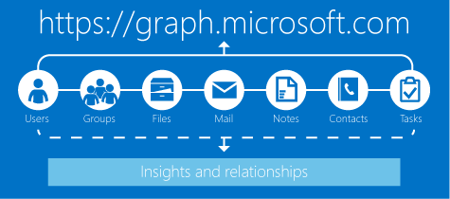
Microsoft Graph API
One endpoint to rule them all
Users
Groups
Files
Mail
Notes
Contacts
Tasks
Notes:
Jakob

Slide 4
Graph – Webhook Subscriptions
Actions
Created, Updated, Deleted
Outlook
Mail
Events
Contacts
Outlook groups
Conversations
(so far)
Notes:
Jakob

Slide 5








New Email Service Now Incident
Email Sent
New/Update Incident
End Users
Webhook
OMS Automation
Orchestrator
Notes:
Jakob

Slide 6

Graph API – Webhook Validation
POST using Validation Token
Return Validation Token
Notes:
Jakob

Slide 7
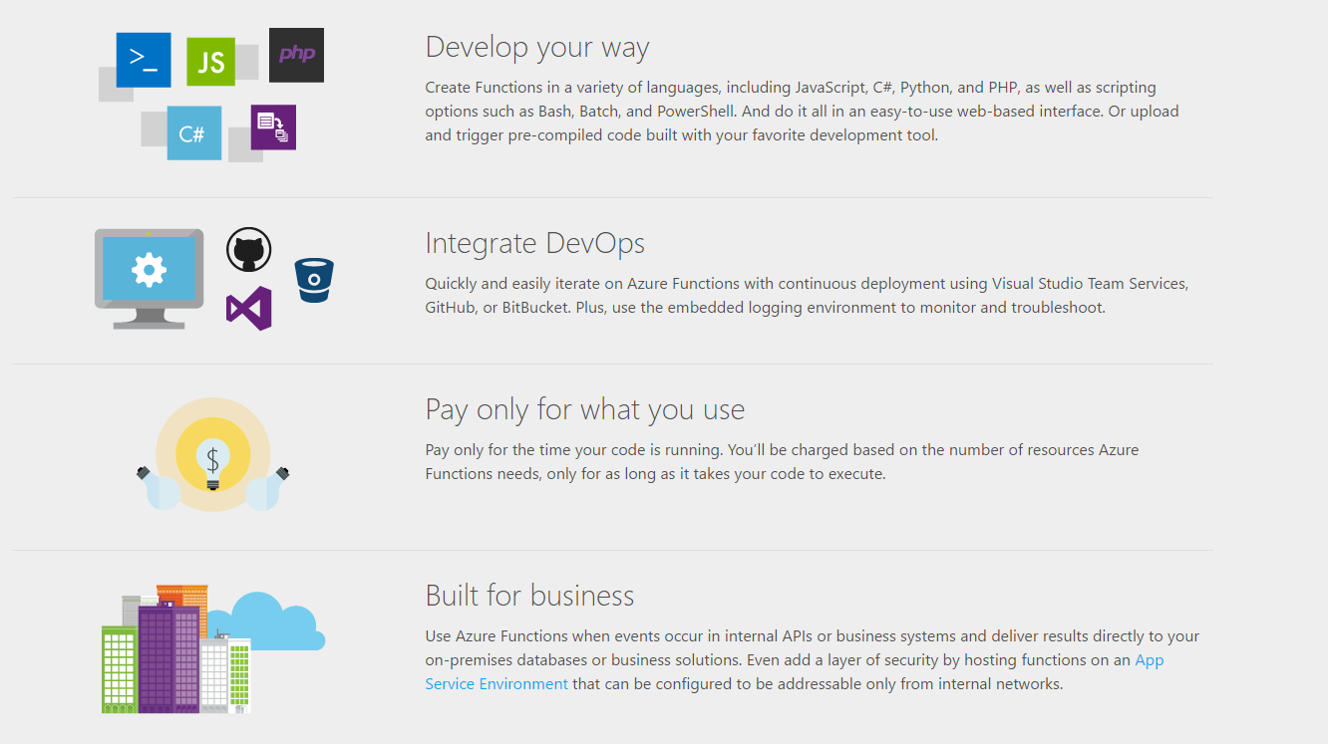
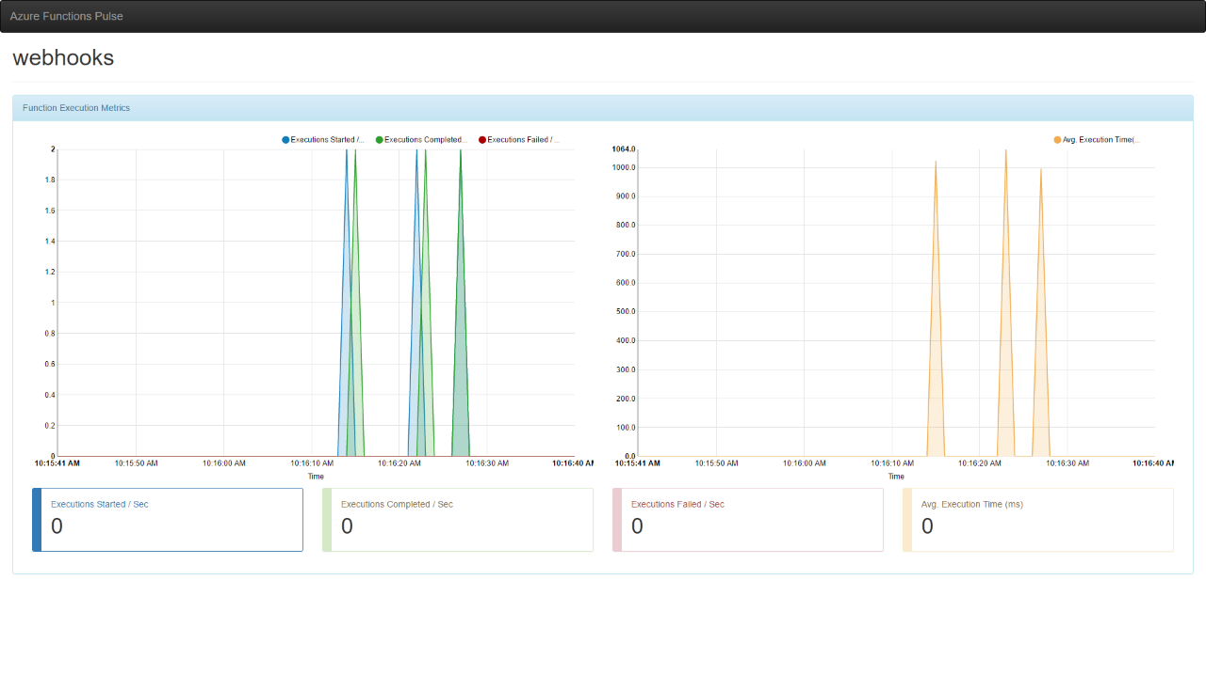
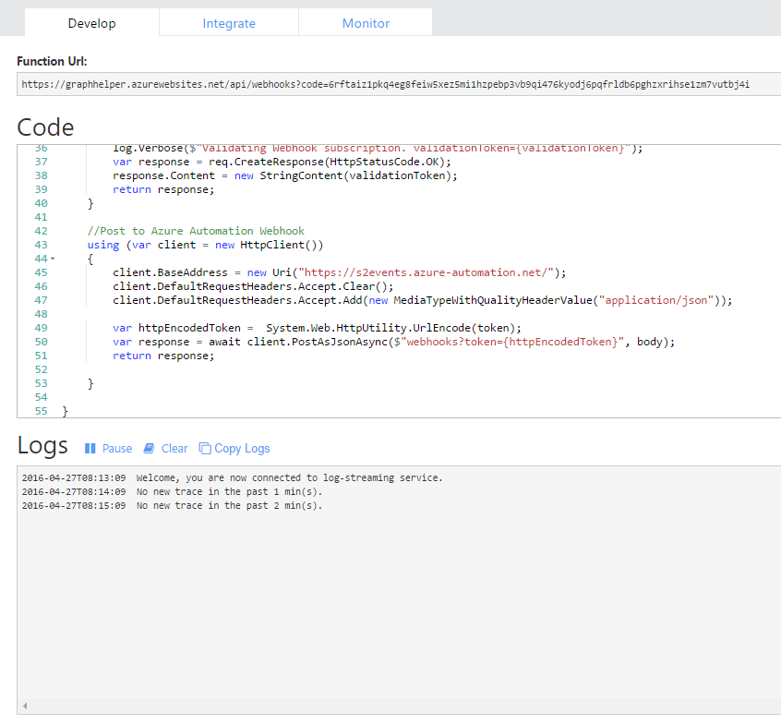
Azure Functions
http://functions.azure.com
Notes:
Vlad

Slide 8

New Email Service Now Incident
Email Sent
New/Update Incident
End Users
Webhook
Azure
Function
OMS Automation
Orchestrator
Notes:
Jakob

Slide 9
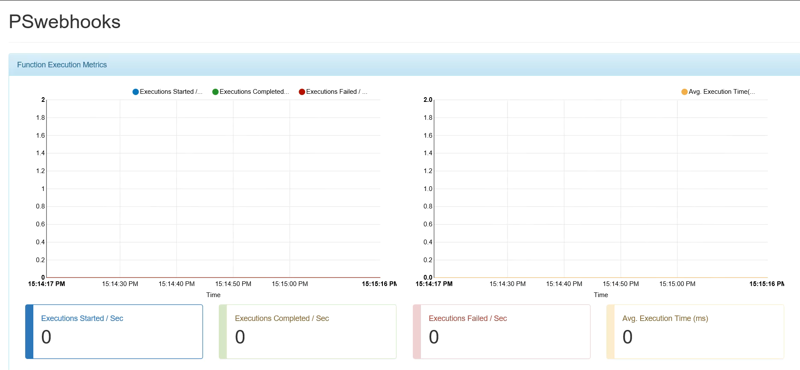
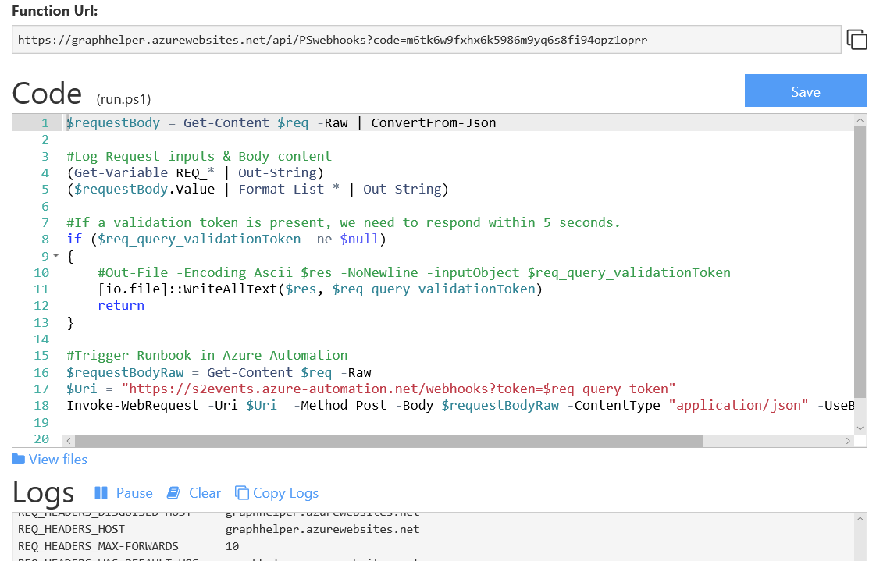
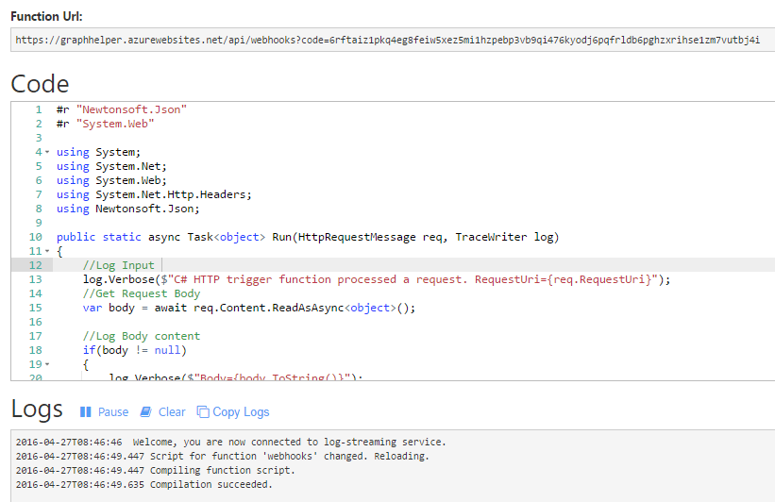
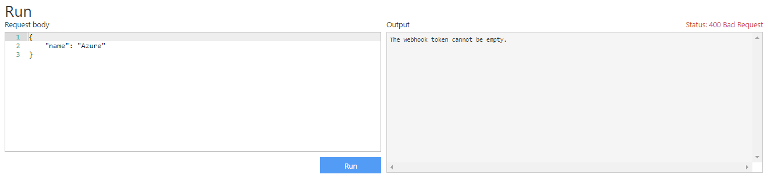
Azure Functions
Premade Templates (C#, PS and more)
Real time monitoring
No need for compilation
Real time log
Quick Testing
Notes:
Vlad

Slide 10
Demo
Graph API + Functions

Slide 11
Update Subscriptions
Maximum expire date = 3 days from creation!
What to do?
Scheduled Runbook!!

Slide 12
Update Subscriptions
Where to save the settings such as URL and subscription ID
JS/XML File?
Custom DB?
SharePoint?

Slide 13
Calling all SharePoint Fans!

Slide 14

All SharePoint Fans!
Go To the Pool!

Slide 15
Demo
Update Subscriptions

Slide 16
Runbook Watchers (Monitor)
In preview
Execute every minute (or less).
Watcher Runbook
Check source then Invoke Action
Free to run, only runs on Hybrid Worker
Maximum 30 seconds
Action Runbook
Perform integrations
Not Free
Runs in Azure or Hybrid Worker

Slide 17
Watcher – SCOM Alerts
New/Update Incident
Watcher
Runbook
Action Runbook
Data
Source
Condition
Detection
Alert
Agent
SCOM
Automation

Slide 18
Demo
Watcher
SCOM Alerts

Slide 19
#Watcher
#Trigger Action(s)
[hashtable]$prop = @{}
$prop.alerts = "$($alerts | COnvertTo-JSON -Depth 1)"
Invoke-AutomationWatcherAction -Message "New Alert" `
-CustomProperties $prop

Slide 20
#Action
#Property Bag
$EVENTDATA.EventProperties.PropertyBag
#Action Input
class PSCustomObject
{
Type = WatcherEvent
InvocationId = c1a3a509-c5da-4f51-9dd7-ce81a25d2e33
EventProperties =
class PSCustomObject
{
TimeStamp = 2017-05-01T13:06:24.7941901Z
PropertyBag =
class PSCustomObject
{
alerts = {
"ManagementGroup": "OMCloudMG",
...
"ResolutionState": 1,
...
"Severity": 2,
...
}
}
Message = New Alert
WatcherName = SCOM-Alerts-Service-Now
}
}

Slide 21
Watcher pitfalls
Watcher maximum runtime = 30 seconds
Watcher code is only updated when creating the watcher
Only Errors and invoke-actions are logged to watcher log
Remember my learnings are based on an early preview!

Slide 22
Export Tool
Pre-Preview! (Alpha?)
Export Runbooks
Auto Export referenced runbook
Auto export used assets

Slide 23
Demo
Export Tool

Slide 24
Debugging Tips
Use a trap to trap any error
Breakpoint in trap

Slide 25
Demo
The Dev trap!

Slide 26
$ErrorActionPreference = "stop"
trap [Exception] {
$ErrorMessage = "SCRIPT: SCSM-ImportData.ps1 failed`n"
$ErrorMessage += "Runas domain: $($env:userdomain)`n"
$ErrorMessage += "Script location: $PSScriptRoot`n`n"
$ErrorMessage += "Error: Line,char: {0},{1} - Details: {2}" -f $_.InvocationInfo.ScriptLineNumber,$_.InvocationInfo.OffsetInLine, $_.Exception
throw $ErrorMessage
continue;
}

Slide 27
Summary
Graph API rules them all!
Watcher runbooks for monitoring
Use SharePoint lists
Export tool for exporting packages of runbooks / complete solutions

Slide 28
About_Author
Jakob Gottlieb Svendsen
@JakobGSvendsen
Global Lead Dev at Coretech Global
www.coretech.global
Blog: http://blog.coretech.dk/jgs/
Cloud & Data Center MVP

Slide 29
Next Steps...
Now: 15 min break
Grab a coffee
Stay here to enjoy next presentation
Change track and switch to another room
Ask me questions or meet me in a breakout session room afterwards

Slide 30
Questions?

Slide 31
Simple Console Demos
# Embed one-liners right into your slides:
PS> Get-ExecutionPolicy
Bypass

Slide 32
Demo
Try and use demos instead of dead slides.
Please do not dive into zillions of pages of code.
Instead, if you can, turn your logical code blocks into functions, and store them in a module.
Share this module with your audience.

Slide 33
# use this template for code samples
# and follow these instructions to show perfectly
# color-coded PowerShell code:
# paste code to PowerShell ISE, select it, and copy it
# to the clipboard
Paste-Code -toISE | Select-Code | Copy-ToClipboard
# to insert it with full color coding into a slide,
# paste the code to your PPT slide. It will be black,
# and there is a toolbutton labelled (Ctrl) in PPT.
Click-ToolButton -Choose SymbolWithClipboardAndBrush
# Click the toolbutton, and choose the button that shows
# a clipboard with a brush. This will add color coding
# back to the pasted code
PLEASE NOTE: You do not need to use ISE to code, or to demo. Use whatever editor you like best.
These steps use ISE to color-code your code correctly and consistently, and insert the color-coded code into the slide. Please help make all code look consistent. Many thanks!

